Slide 1
Concepts of OOPs

Slide 2
What is OOPS?
Object-Oriented Programming is a methodology to design a program using classes and objects.
It simplifies software development and maintenance by providing some concepts:
Classes
Object
Abstraction
Encapsulation
Inheritance
Polymorphism

Slide 3
Collection of objects is called class. A class can also be defined as a blueprint from which you can create an individual object.
Any entity that has state and behavior is known as an object. An Object can also be defined as an instance of a class.
Hiding internal details and showing functionality is known as abstraction.
Binding (or wrapping) code and data together into a single unit are known as encapsulation.
When one object acquires all the properties and behaviors of a parent object, it is known as inheritance. It provides code reusability.
If one task is performed in different ways, it is known as polymorphism.

Slide 4
Overview of Java

Slide 5
What is java?
Java is a general-purpose, class-based, object-oriented programming language designed for having lesser implementation dependencies.
Java is a high level, robust, object-oriented and secure programming language.
Java was developed by sun microsystem in 1995. James Gosling is known as the father of Java.
Before Java, its name was Oak. Since Oak was already a registered company, so James Gosling and his team changed the name from Oak to Java.

Slide 6
Java Applications
A Java application is a Java programme that may run independently on a client computer or a server computer. After being interpreted by the JVM and executed by the JRE, Java applications are granted unrestricted access to all system resources.
There are mainly 4 types of applications that can be created using Java programming
Standalone application
Web application
Enterprises application
Mobile application

Slide 7
Features of java
Simple
Object oriented
Portable
Platform independent
Secured
Distributed
Multithreading
High performance

Slide 8
Java platform/Editions
Java SE (Java standard Edition)
Java EE (Java Enterprise Edition)
Java ME (Java micro Edition)
Java FX

Slide 9
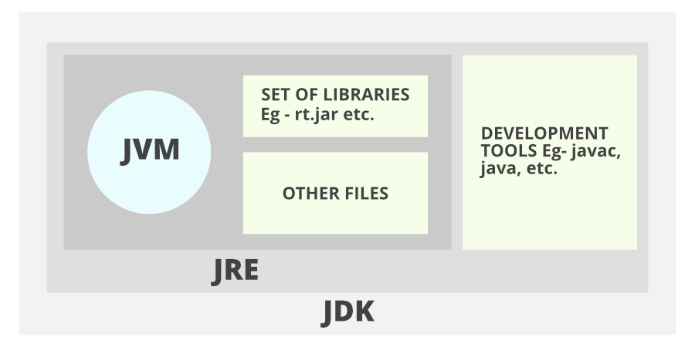
Java Environment

Slide 10
Java Feature - Platform Independent
Java is platform independent because it is different from other languages like C, C++, etc. which are compiled into platform specific machines while Java is a write once, run anywhere language.
When a java programmer writes the program the compilation is done by the JAVAC compiler which is a primary Java compiler included in the Java development kit (JDK). It takes the Java program as input and generates bytecode as output.JVM executes the bytecode generated by the compiler.

Slide 11
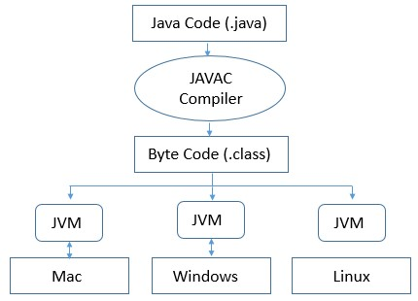

Slide 12
Difference Between C++ and Java
TOPIC | C++ | Java
Memory Management | Use of pointers, structures, union | No use of pointers. Supports references, thread and interfaces.
Libraries | Comparatively available with low-level functionalities | Wide range of classes for various high-level services
Multiple Inheritance | Provide both single and multiple inheritance. | Multiple inheritances is partially done through interfaces
Operator Overloading | Supports operator overloading | It doesn’t support this feature
Program Handling | Functions and variables can reside outside classes. | Functions and variables reside only in classes, packages are used.
Portability | Platform dependent, must be recompiled for different platform | Platform independent, byte code generated works on every OS.
Thread Support | No built-in support for threads, depends on libraries. | It has built-in thread support.

Slide 13
Difference Between Java and Python
TOPIC | Java | Python
Compilation process | Java is both compiled and interpreted language, which is first compiled and then interpreted into a byte code. | Python is an interpreted programming language
Code Length | Longer lines of code as compared to python. | 3-5 times shorter than equivalent Java programs.
Syntax Complexity | Define particular block by curly braces, end statements by ; | No need of semi colons and curly braces, uses indentation
Ease of typing | Strongly typed, need to define the exact datatype of variables | Dynamic, no need to define the exact datatype of variables.
Speed of execution | Java is much faster than python in terms of speed. | Expected to run slower than Java programs
Multiple Inheritance | Multiple inheritance is partially done through interfaces | Provide both single and multiple inheritance

Slide 14
What is a class in Java?
A class in Java is a blueprint from which an object is created.
The classes in Java are generally classified under two categories
Built-in Classes: Built-in classes in Java are the classes which come bundled within predefined packages in Java.
User-Defined/ Custom Classes: A custom or user-defined class is a class that is created by a user. It will contain the class members as defined by the user.

Slide 15
Syntax to declare a class:
class <class_name>
{
field;
method;
}
Objects in Java
Object is an instance of class that executes the class.
Syntax to create object
class_name obj_name= new class_name();

Slide 16
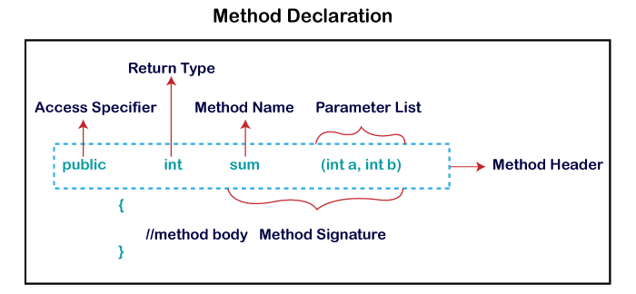
Method in Java
A method is a block of code or collection of statements, or a set of code grouped together to perform a certain task or operation. It is used to achieve the reusability of code.
The most important method in Java is the main() method.
Method Declaration

Slide 17
First Short Program
To create a simple Java program, you need to create a class that contains the main method.
class Simple
{
public static void main(String args[])
{
System.out.println("Hello Java");
}
}

Slide 18
A Second Short Program
The below program shows how a variable is declared and how it is assigned a value.
class Example2
{
public static void main(String args [])
{
int num; // this declares a variable called num
num = 100; // this assigns num the value 100
System.out.println("This is num: " + num);
num = num * 2;
System.out.print("The value of num * 2 is ");
System.out.println(num);
}
}

Slide 19
Data Types in Java
Data types specify the different sizes and values that can be stored in the variable. There are two types of data types in Java:
Primitive data types: The primitive data types include Boolean, char, byte, short, int, long, float and double.
Non-primitive data types: The non-primitive data types include Classes, Interfaces and Arrays.

Slide 20
Java Variables
A variable is a container which holds the value while the java program is executed. A variable is assigned with a data type
There are three types of variables in java:
Local Variables
Instance Variables
Static Variables

Slide 21
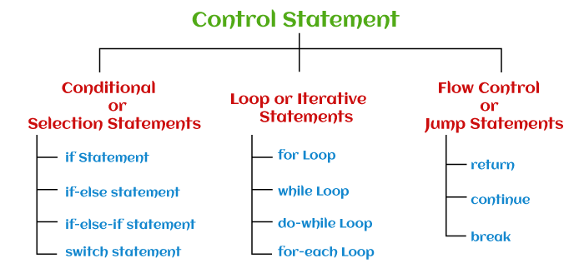
Control Statements

